Slide 1
The Link between the Structure and Function of the Infrapatellar Plica and Anterior Knee Pain
Thomas V. Smallman, MD
Upstate Medical University & Auburn Community Hospital
Amos Race, PhD
Upstate Medical University, Syracuse, New York
Kris Shekitka, MD
St-Agnes Hospital,Baltimore, Maryland
Ken Mann, PhD
Upstate Medical University, Syracuse, New York
Notes:
One does not tread lightly into the black hole of orthopaedics. The objective of this presentation is to describe a new theory for the etiology for anterior knee pain.
The Link between the Structure and Function of the Infrapatellar Plica and Anterior Knee Pain

Slide 2
INTRODUCTION
Background Literature
In the German article Die Plica synovialis infrapatellaris beim Menschen ^{1 .} F. Wachtler described the teleology, gross anatomy, histology of the infrapatellar plica (IPP) and discussed its function. He injected the fat pad (FP) with radiographic contrast and concluded “…from a mechanical and teleological point of view, the IPP may have little relevance…” He did not demonstrate the histology, nor the radiographic studies. The IPP has in the subsequent literature been described as a structure without a function, seemingly at odds with one of the tenets of nature that structure and function are intimately linked. Typical comments include:
“…most recent literature on the pathology of plica claims that the infrapatellar plica has little clinical relevance and does not cause symptoms…”²
“…It is generally agreed that the infrapatellar plica does not cause symptoms…” ^{3,4}
Clinical Concept
Interestingly, releasing the femoral insertion of the IPP improves idiopathic anterior knee pain (AKP) in most. This observation is supported by 4 reports on small series of patients
Boyd: 12 patients, 12 knees ²
Demirag: 14 patients, 14 knees⁵
Kim: 2 separate reports, 3 patients, 3 knees ^{6,7}
E-Poster # EFORT12-5557 reports that in adolescent AKP, release of the IPP benefits 84% (44 of 49 knees in 35 patients who had failed conservative management with a mean F/U of 64 months
The Dilemma
There is a paradox: on the one hand the simple procedure of releasing the IPP helps AKP; on the other, the literature suggests that the IPP is an embryonic remnant, a synovial fold of no clinical significance.
Wachtler: Die Plica Synovialis infrapatellaris beim Menschen, Acta Anat (Basel), 1979;104:451-459.
Boyd CR, Eakin C, Matheson GO. Infrapatellar plica as a cause of anterior knee pain. Clinical Journal of Sport Medicine. 2005;15:98-103.
Hardaker W, et al: Diagnosis and treatment of the plica syndrome of the knee. J Bone Joint Surg Am 1980
O’Dwyer KJ, Peace PK. The Plica Syndrome Injury 1988, 19, Issue 5: 350-352
Demirag, B; Ozturk, C; Karakayali K. Symptomatic infrapatellar plica. Knee Surg Sports Traumatol Arthrosc 2006,14: 156–160
Kim, SJ, Chloe; Pathological Infrapatellar Plica: A Report of Two Cases and Literature Review. Arthroscopy: The Journal of Arthroscopic and Related Surgery, 1996, Vol 12, No 2: 236-239
Kim SJ, Kim JY, Lee JW, Pathologic Infrapatellar Plica. Arthroscopy: The Journal of Arthroscopic and Related Surgery, 2002, Vol 18, No 5: pp 1 - 5

Slide 3
INTRODUCTION
Generation of the hypothesis
The objective of this study is to explain how releasing the infrapatellar plica (IPP) eliminates AKP. An initial review of the structure (gross anatomy and histology) of the synovial layer of the knee, including IPP and fat pad (FP), is followed by physiologic experiments. This review expands on Wachtler’s original anatomic and histologic observations. The experiments involve repeating F. Wachler’s described injection of the FP, first in cadaver specimens, then in volunteers undergoing arthroscopy. Analysis of the experiments allows development of the hypothesis. The principle is to link structure and function at all levels.
Sentinel Patient
The original concept arose during care of a sentinel patient, a superbly fit 30 y/o man seeking to be the fittest soldier in the Canadian Forces:
A triathlete, he developed AKP after a drastic increase in intensity of training ; over 6 months
he was unable to perform his job; he faced possible release from the military
Arthroscopy revealed a pristine knee in which the only abnormality was a dollop of inflammation at the apex of the infrapatellar plica ( IPP )
This focused observation on the rope-like IPP, which demonstrated unexpected mechanical behavior as the knee was passively moved through the arc of motion; this non-isometric behavior is described as follows (see video of a similar patient next slide) :
From the standard anterolateral portal the IPP is seen as a lax structure with the knee in mid flexion
Approaching full extension, IPP is seen to contact the apex of the notch, and with further extension, disappear; in full extension observation is difficult as the FP is drawn against the end of the femur and the IPP disappears
approaching flexion at 90 degrees, the IPP appears taut and linear
release of the femoral attachment of the IPP liberates the FP from this central distortion allowing it to act under forces of shear, compression, and distraction, sandwiched against the femoral condyles
This soldier was able to return to duty with complete relief of his symptoms.
The demonstrated mechanical link involving FP capture and non-isometric behavior of the IPP may represent the anatomical basis for AKP. Severing the attachment of the IPP frees the FP. Denervation may play a role as well.

Slide 4
Notes:
Focus on the plica , which initially appears relaxed, then as the knee approaches extension it contacts the apex of the notch, appears to retract, and the fat pad is drawn firmly against the distal femur. In flexion in also seems to tighten. There is definite mechanical contact with the femur as the knee toggles.

Slide 5
INTRODUCTION
BACKGROUND DATA: Review of of Anatomy, Biomechanics, Arthroscopic Observations, and Generation of Hypothesis
From Kim: “…The infrapatellar plica is commonly called the ligamentum mucosum. It is a synovial fold that originates from the intercondylar notch of the femur, runs parallel to and above the anterior cruciate ligament, and attaches to the infrapatellar fat pad…”. ⁸ This 2 dimensional view of the IPP is from the arthroscopic literature. This understates the origins of the IPP which arise from above.
Anatomic Observation: The synovial layer is a continuum from its intimate attachment to the undersurface of the vasti, sending folds around the patella, through and over the fat pad merging to become the IPP. ⁹ The IPP is thus linked anatomically to the undersurface of the quads mechanism. The medial plica and the more robust medial shelf are also simply part of this continuum. Note that they merge with the medial alar fold which becomes part of the IPP. This 3 dimensional description connects the IPP anatomically to knee motion by virtue of these connective tissue links.
Biomechanical Observation: As the knee moves through its arc of motion, the FP, through its central body and the IPP, rotates around the fixed point of its attachment at the apex of the notch. As this attachment is not co-located the flexion/extension axis (constant and directed from anterosuperior on the medial side to posteroinferior on the lateral side, passing through the origins of the medial and lateral collateral ligaments and superior to the crossing point of the cruciates.), the IPP must act non-isometrically, changing in conformation (length, shape, and tension) as the knee moves through the arc of motion. As the FP attachment of the IPP is the soft tissue central body, it must distort as well. This is the key concept in linking AKP to the IPP/FP complex, as the central body is highly innervated.
Arthroscopic Observation (review video): Through direct observation one notes this non-isometric mechanical behaviour of the IPP. It appears lax in mid flexion, appears to contact the apex of the notch as the knee approaches full flexion. Throughout the arc of motion the IPP maintains the FP against the end of the femur. It appears to tighten and become linear as the knee approaches 90 degrees of flexion. Release of the IPP insertion frees the fat pad so that it is not held captive against the femur.
Hypothesis: The knee is a form of “…biologic transmission…” ¹⁰ The muscles provide motor force; the capsule (including ligaments), menisci, and the synovial layer participate in providing sensation, and force transmission and attenuation. The IPP, attached to the bony central anchor, acts as a non-isometric intra-articular ligament, tethering the fat pad at its central body. The effect of knee motion is to impart stretch and relaxation to the IPP and central body, transmitting force to its attachments at the femur, and the FP.
CLINICAL IMPLICATION:
Releasing the femoral attachment of the IPP releases the mechanical capture of the FP, a highly innervated and sensate structure, allowing it to move without this central distortion.
Pain relief can result from the removal of the mechanical pull on the IPP, and / or denervation.
8. Kim SJ, Choe WS. Arthroscopic Findings of the Synovial Plicae of the Knee. Arthroscopy: The Journal of Arthroscopic and Related Surgery, Vol 13, No 1 (February), 1997: pp 33-41
9. Gray H. Gray's Anatomy. 2005. xx ed. Edinburgh ; New York: Elsevier Churchill Livingstone.
10. Dye, S. The Pathophysiology of Patellofemoral Pain -- A Tissue Homeostasis Perspective, Clinical Orthopaedics and Related Research, 2005, Number 436, pp. 100–110

Slide 6
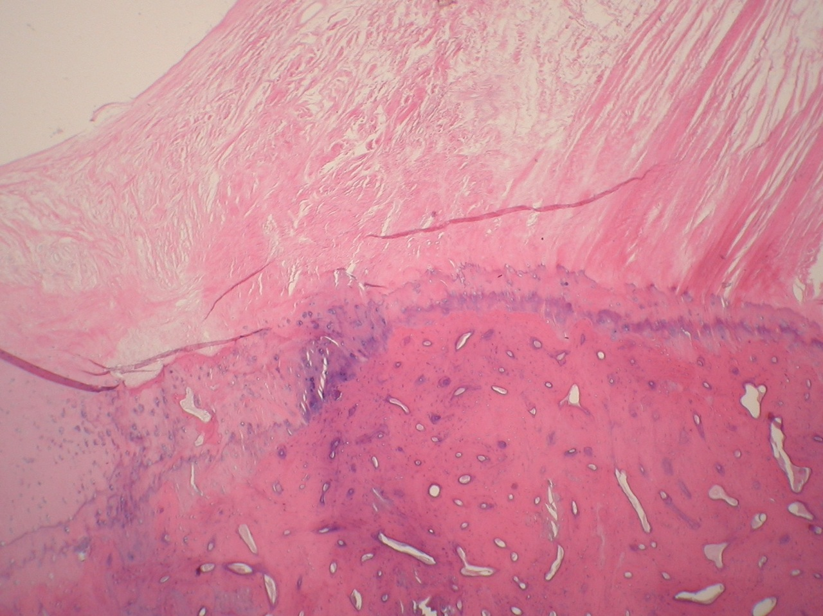
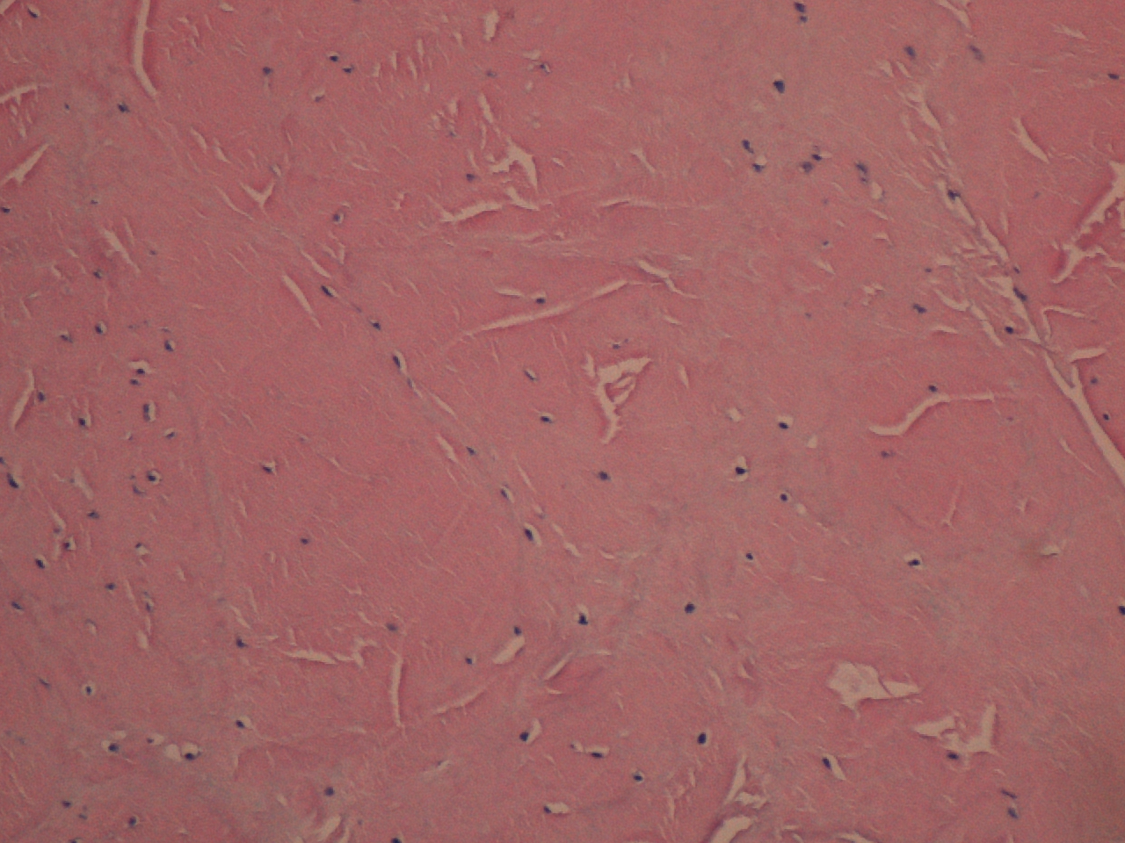
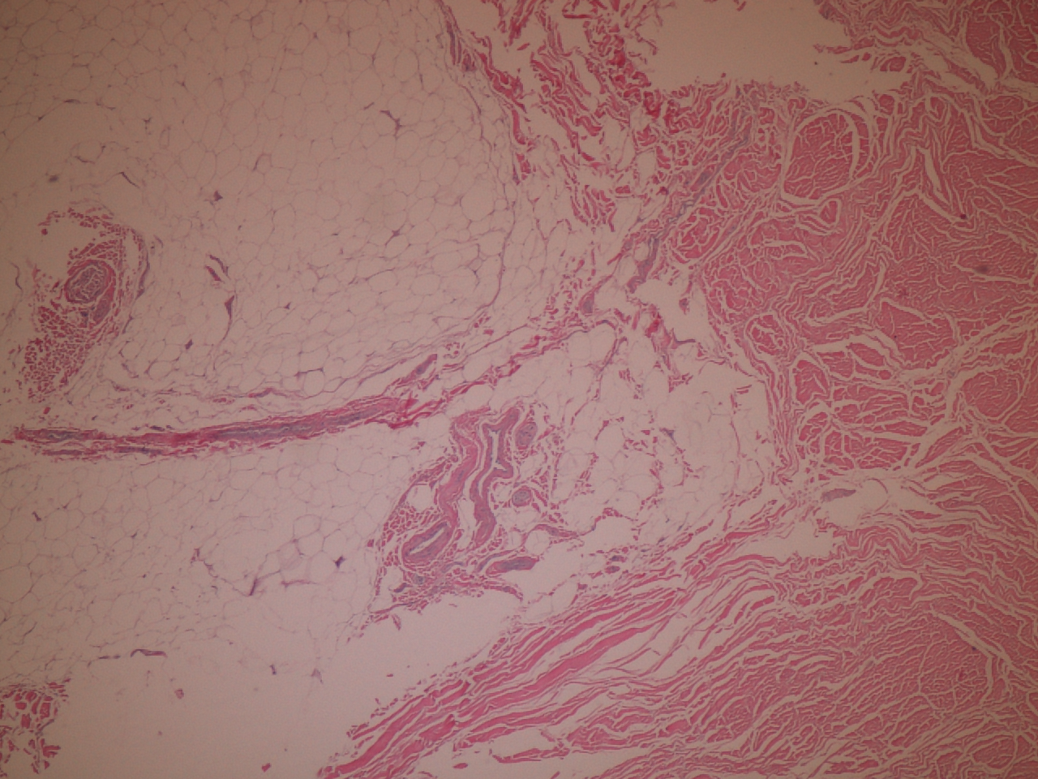
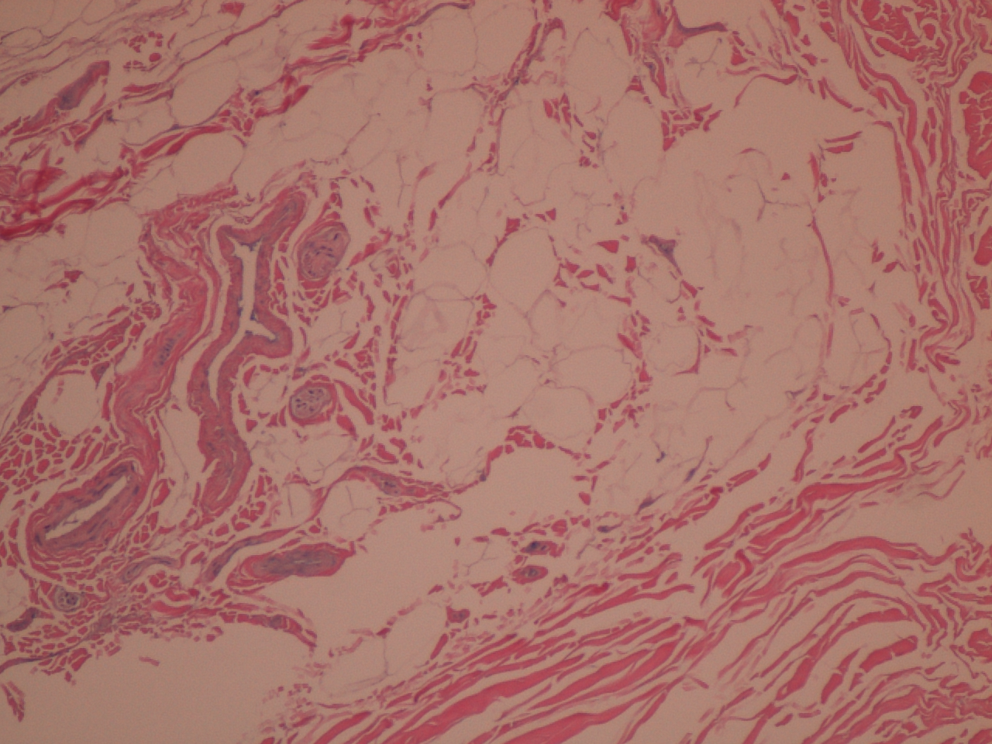
MATERIALS AND METHODS
Histology of the infrapatellar plica (IPP) supports Wachtler’s verbal description:
Structure is linked to function – IPP as seen in B is a dense connective tissue structure with specialized attachments (A, C, D). Femoral ttachment at A is ligament-like. Attachment to fat pad at C and D contains tortuous neurovascular bundles implying the capability of stretch. The IPP arises from the alar folds and is connected to the extensor apparatus. The IPP is a true ligament.
A. Femoral Attachment: Connective tissue (CT) above, fibrocartilagenous transition zone to cortical bone below.
Cross-section of rope-like IPP in mid portion shows
dense connective tissue, analagous to any ligament.
C. Central Body IPP Attachment: finger-like projections of CT merge with the CT of lobulated fat pad.
D. Central Body Neurovascular (NV) Bundle: lodged between the
CT attachment is a NV bundle. The central body is highly innervated.
Notes:
So here is the histologic structure of the IPP: the top 2 slides show on the left that the femoral attachment of the IPP is ligament-like with fibrocartilagenous differentiation between the dense connective tissue above and cortical bone below. On the top right is the dense connective tissue in cross-section of the the rope-like portion of the plica, identical to a ligament. The insertion in the fat pad, its central body, is a finger-like splaying out of the connective tissue, which merges with the fibro-elastic elements of the fat pad. The area is rich in tortuous vessels and nerves, implying capability of stretch.

Slide 7
MATERIALS AND METHODS
Cadaver studies: In 2 fresh frozen cadaver knees arthroscopy was performed to verify normal anatomy and the presence of an IPP. Direct arthroscopic visualization was used to control implantation of contrast material in the FP and IPP. Saline source was positioned 2 ft above the knee imparting a pressure of 74 mm Hg to the articular space. Manual traction through 5-0 Ethibond sutures in the quadriceps muscle group mimicked motion, recorded through lateral fluoroscopy. The femoral attachment of the IPP was then released and knee motion repeated and recorded.
In-Vivo Study: In an IRB approved study of 12 volunteers undergoing planned knee arthroscopy under local anesthesia, contrast was placed in the FP and IPP under lateral fluoroscopic control. Passive, then active motion then a quads-set manoeuvre was performed. The IPP was resected and knee motion again recorded.
Cadaver studies: Videos from the cadaver studies (see first video, next slide) demonstrated that the IPP elongated with FP distortion as the knee approached full extension and flexion, and that the IPP was lax through mid arc. Release of the IPP at the femur eliminated almost all of the distortion through the full arc of motion.
In-Vivo Study: Successful visualization of the IPP was achieved in only 4 patients in the In-Vivo Study (see second video slide to follow). However, in all cases, the videos replicated the cadaveric observations for passive and, for the first time in living patients, active motion. The quads set manoeuvre caused further distortion of the FP with the patella moving one cm proximally. Release of the IPP eliminated FP distortion.
SUMMARY AND CONCLUSION
Knee motion was recorded by lateral fluoroscopy in 2 cadaver, and 4 in-vivo knees. The videos showed in all instances stretch and deformation of the central body and region of the FP and IPP as the knees approached full extension and flexion. This non-isometric mechanical behaviour of the IPP shows that, by virtue of is central attachment, it holds the FP captive against the femur. Release of the IPP eliminates this mechanical effect of the IPP on the FP. Pain relief can be through denervation, or through release of the innervated central body of the FP.
RESULTS

Slide 10
TAKE HOME POINTS
Idiopathic AKP is associated with the following clinical scenarios:
Adolescent AKP
Overuse
Knee injury (ligament, meniscus, bone)
ACL reconstruction
Intramedullary rodding
What initiates the pain in each is unclear. In most, cytokines associated with injury are elaborated in the unfolding dynamics of the healing process. Inflammation then follows, creating the diathesis for pain. In overuse, the concepts of neurogenic inflammation, induced by unaccustomed stretch, as espoused by M. Bohnsack ¹³ may be the initiating factor.
This study demonstrates a dynamic process of stretch and deformation of the central FP and IPP not previously demonstrated. These obligatory length changes arise because the IPP is not isometric. Every cycle of knee motion imparts these forces and constraints that arise in the deforming IPP directly to the femur on one end, and to the central body of the fat pad on the other. This region that has been shown by S. Dye to be pain-sensitive to direct mechanical pressure ¹⁰. Indirect forces on the patella, not included in the current biomechanical force profiles for the knee, are likely present as a result of the distraction of the IPP and central body of the FP.
The synovial layer of the knee includes a fibrous network including synovial folds linking the extensor apparatus and the infrapatellar plica. The microstructure of the central body of the fat pad reveals a structure whose connective tissue and neurovascular elements appear capable of stretch. The infrapatellar plica is dense connective tissue with a force attenuating fibro-cartilagenous attachment on the femoral end, and the central body, equally adapted to force attenuation of the other. The IPP is an intra-articular ligament that holds the central body of the fat pad captive against the end of the femur.
Studies by Kim , Boyd, Demirag, and Smallman have demonstrated that release of the femoral attachment of the non-isometric infrapatellar plica improves or eliminates the AKP in most. This establishes the link between AKP and the infrapatellar plica. The mechanism of pain relief may be, in part, the mechanical freeing of the painful central body, or may by related to denervation. Idiopathic anterior knee pain could be termed the fat pad capture syndrome, reflecting this described link.
13. Bohnsack,M.; Meier,F.; Walter,G.F.; Hurschler,C.; Schmolke,S.; Wirth,C.J.; Ruhmann,O. Distribution of substance-P nerves inside the infrapatellar fat pad and the adjacent synovial tissue: a neurohistological approach to anterior knee pain syndrome, Arch.Orthop.Trauma.Surg., 2005 Nov, 125, 9, 592-597

